Slide 1
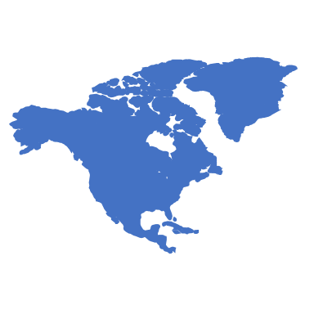
Business Problem
There are thousands of cities around the world. They are very diverse in terms of culture, economy etc. For a tourism company, to group all those popular cities into several cluster is very important. With this information, it will help client to choose the right cities to visit, especially for those tourist who want to experience different cultures.
In this project, we will choose those biggest cities in the world (based on population) , use Foursquare API to retrieve the top popular sites in those cities and then clustering them into several clusters..

Slide 2
Data Used
A list of big cities in the world. We get the list from this link which contains 220+ biggest cities with largest population. https://en.wikipedia.org/wiki/List_of_largest_cities
Latitude and longitude of cities in the world. we get the information from this link: https://simplemaps.com/data/world-cities In the list, it contains the city name, latitude and longitude, country, population, time zone, ranking etc. Based on the object of this, we only the latitude and longitude of those cities.
Foursquare location data We will use the "explore" api to get top places in each city , and then use the categories of those top places as the features, and apply the k-means algorithm to cluster those cities into groups. In the Foursquare "explore" api, we will use the radius 30km (300000m) as the parameter, since this are will almost cover the main area of the city.

Slide 3

Resut and Findings
6 clusters in the end. Below are some interesting finding:
Cities in North America and south America are almost in the same cluster. (cluster 3)
In Asia, the groups of cities are much more diverse.
Most cities in China are in one cluster (cluster 5)
Japan cities are in another cluster which are the same as America cities. This shows that Japan is more westernized that all other Asia countries. Btw, Shanghai, China is also in the same cluster as other America cities. This also matches my feeling. (cluster 3)
Most India cities in cluster 2, and Asean cities are mostly in cluster 1
In Europe, Landon, Paris, Barcelona are of cluster 1, which is interesting, one of reason might be that those cities are of long history and popular tourism cities. (there are many hotels :)

Slide 4
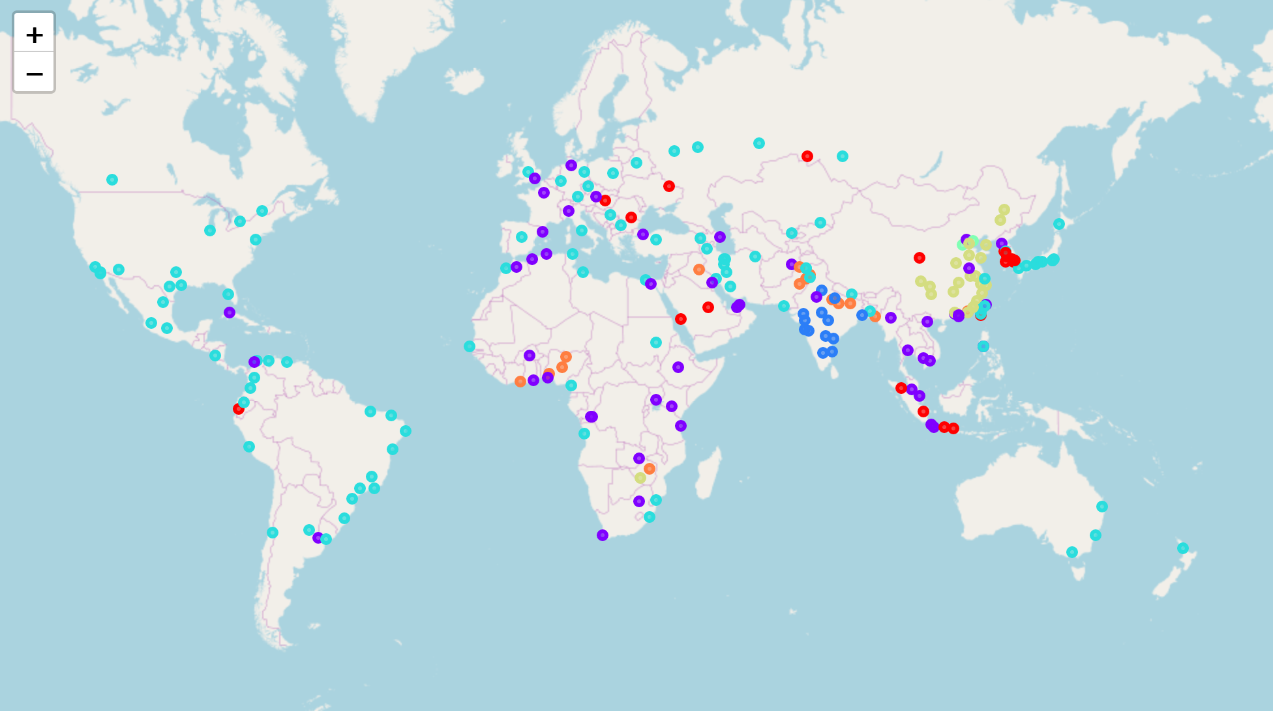
Final Clustering Result

